Slide 1
Insertion Sort
while some elements unsorted:
  Using linear search, find the location in the sorted portion where the 1st element of the unsorted portion should be inserted
  Move all the elements after the insertion location up one position to make space for the new element
45
38
60
45
66
60
45
66
79
47
13
74
36
21
94
22
57
16
29
81
the fourth iteration of this loop is shown here

Slide 2
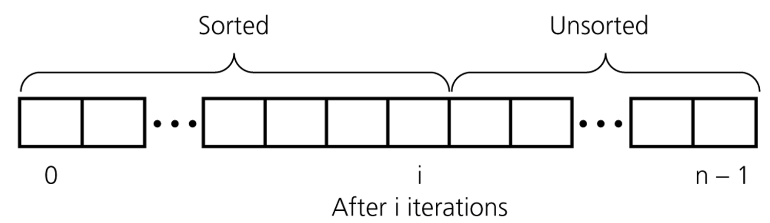
An insertion sort partitions the array into two regions

Slide 3
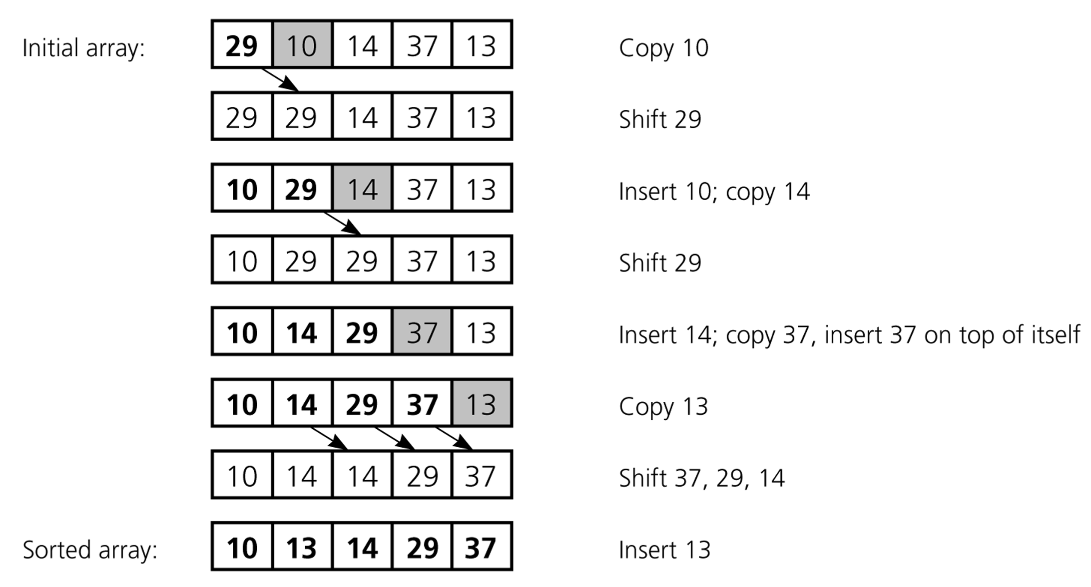
An insertion sort of an array of five integers

Slide 4
Insertion Sort Algorithm
public void insertionSort(Comparable[] arr) {
for (int i = 1; i < arr.length; ++i) {
Comparable temp = arr[i];
int pos = i;
// Shuffle up all sorted items > arr[i]
while (pos > 0 &&
arr[pos-1].compareTo(temp) > 0) {
arr[pos] = arr[pos–1];
pos--;
} // end while
// Insert the current item
arr[pos] = temp;
}
}

Slide 5
Insertion Sort Analysis
public void insertionSort(Comparable[] arr) {
for (int i = 1; i < arr.length; ++i) {
Comparable temp = arr[i];
int pos = i;
// Shuffle up all sorted items > arr[i]
while (pos > 0 &&
arr[pos-1].compareTo(temp) > 0) {
arr[pos] = arr[pos–1];
pos--;
} // end while
// Insert the current item
arr[pos] = temp;
}
}
outer loop
outer times
inner loop
inner times

Slide 6
Insertion Sort: Number of Comparisons
# of Sorted Elements | Best case | Worst case
0 | 0 | 0
1 | 1 | 1
2 | 1 | 2
… | … | …
n-1 | 1 | n-1
 | n-1 | n(n-1)/2
Remark: we only count comparisons of elements in the array.

Slide 7
Insertion Sort: Cost Function
1 operation to initialize the outer loop
The outer loop is evaluated n-1 times
  5 instructions (including outer loop comparison and increment)
  Total cost of the outer loop: 5(n-1)
How many times the inner loop is evaluated is affected by the state of the array to be sorted
Best case: the array is already completely sorted so no “shifting” of array elements is required.
  We only test the condition of the inner loop once (2 operations = 1 comparison + 1 element comparison), and the body is never executed
  Requires 2(n-1) operations.

Slide 8
Insertion Sort: Cost Function
Worst case: the array is sorted in reverse order (so each item has to be moved to the front of the array)
  In the i-th iteration of the outer loop, the inner loop will perform 4i+1 operations
  Therefore, the total cost of the inner loop will be 2n(n-1)+n-1
Time cost:
  Best case: 7(n-1)
  Worst case: 5(n-1)+2n(n-1)+n-1
What about the number of moves?
  Best case: 2(n-1) moves
  Worst case: 2(n-1)+n(n-1)/2

Slide 9
Insertion Sort: Average Case
Is it closer to the best case (n comparisons)?
The worst case (n * (n-1) / 2) comparisons?
It turns out that when random data is sorted, insertion sort is usually closer to the worst case
  Around n * (n-1) / 4 comparisons
  Calculating the average number of comparisons more exactly would require us to state assumptions about what the “average” input data set looked like
  This would, for example, necessitate discussion of how items were distributed over the array
Exact calculation of the number of operations required to perform even simple algorithms can be challenging
(for instance, assume that each initial order of elements has the same probability to occur)

Slide 10
Bubble Sort
Simplest sorting algorithm
Idea:
  1. Set flag = false
  2. Traverse the array and compare pairs of two consecutive elements
    1.1 If E1 ≤ E2 -> OK (do nothing)
    1.2 If E1 > E2 then Swap(E1, E2) and set flag = true
  3. repeat 1. and 2. while flag=true.

Slide 11
Bubble Sort
1 23 2 56 9 8 10 100
1 2 23 56 9 8 10 100
1 2 23 9 56 8 10 100
1 2 23 9 8 56 10 100
1 2 23 9 8 10 56 100
---- finish the first traversal ----
1 2 23 9 8 10 56 100
1 2 9 23 8 10 56 100
1 2 9 8 23 10 56 100
1 2 9 8 10 23 56 100
---- finish the second traversal ----
…

Slide 12
Bubble Sort
public void bubbleSort (Comparable[] arr) {
boolean isSorted = false;
while (!isSorted) {
isSorted = true;
for (i = 0; i<arr.length-1; i++)
if (arr[i].compareTo(arr[i+1]) > 0) {
Comparable tmp = arr[i];
arr[i] = arr[i+1];
arr[i+1] = tmp;
isSorted = false;
}
}
}

Slide 13
Bubble Sort: analysis
After the first traversal (iteration of the main loop) – the maximum element is moved to its place (the end of array)
After the i-th traversal – largest i elements are in their places
Time cost, number of comparisons, number of moves -> Assignment 4

Slide 14
O Notation

Slide 15
O-notation Introduction
Exact counting of operations is often difficult (and tedious), even for simple algorithms
Often, exact counts are not useful due to other factors, e.g. the language/machine used, or the implementation of the algorithm (different types of operations do not take the same time anyway)
O-notation is a mathematical language for evaluating the running-time (and memory usage) of algorithms

Slide 16
Growth Rate of an Algorithm
We often want to compare the performance of algorithms
When doing so we generally want to know how they perform when the problem size (n) is large
Since cost functions are complex, and may be difficult to compute, we approximate them using O notation

Slide 17
Example of a Cost Function
Cost Function: t_{A}(n) = n² + 20n + 100
  Which term dominates?
It depends on the size of n
  n = 2, t_{A}(n) = 4 + 40 + 100
    The constant, 100, is the dominating term
  n = 10, t_{A}(n) = 100 + 200 + 100
    20n is the dominating term
  n = 100, t_{A}(n) = 10,000 + 2,000 + 100
    n² is the dominating term
  n = 1000, t_{A}(n) = 1,000,000 + 20,000 + 100
    n² is the dominating term

Slide 18
Big O Notation
O notation approximates the cost function of an algorithm
  The approximation is usually good enough, especially when considering the efficiency of algorithm as n gets very large
  Allows us to estimate rate of function growth
Instead of computing the entire cost function we only need to count the number of times that an algorithm executes its barometer instruction(s)
  The instruction that is executed the most number of times in an algorithm (the highest order term)

Slide 19
Big O Notation
Given functions t_{A}(n) and g(n), we can say that the efficiency of an algorithm is of order g(n) if there are positive constants c and m such that
  t_{A}(n) · c.g(n) for all n ¸ m
we write
  t_{A}(n) is O(g(n)) and we say that
  t_{A}(n) is of order g(n)
e.g. if an algorithm’s running time is 3n + 12 then the algorithm is O(n). If c is 3 and m is 12 then:
  4 * n ≥ 3n + 12 for all n ≥ 12

Slide 20
In English…
The cost function of an algorithm A, t_{A}(n), can be approximated by another, simpler, function g(n) which is also a function with only 1 variable, the data size n.
The function g(n) is selected such that it represents an upper bound on the efficiency of the algorithm A (i.e. an upper bound on the value of t_{A}(n)).
This is expressed using the big-O notation: O(g(n)).
For example, if we consider the time efficiency of algorithm A then “t_{A}(n) is O(g(n))” would mean that
  A cannot take more “time” than O(g(n)) to execute or that
  (more than c.g(n) for some constant c)
  the cost function t_{A}(n) grows at most as fast as g(n)

Slide 21
The general idea is …
when using Big-O notation, rather than giving a precise figure of the cost function using a specific data size n
express the behaviour of the algorithm as its data size n grows very large
so ignore
  lower order terms and
  constants

Slide 22
O Notation Examples
All these expressions are O(n):
  n, 3n, 61n + 5, 22n – 5, …
All these expressions are O(n²):
  n², 9 n², 18 n²+ 4n – 53, …
All these expressions are O(n log n):
  n(log n), 5n(log 99n), 18 + (4n – 2)(log (5n + 3)), …

